Slide 1
Supervised Learning I: Perceptrons and LMS
Instructor: Tai-Yue (Jason) Wang
Department of Industrial and Information Management
Institute of Information Management

Slide 2
Two Fundamental Learning Paradigms
Non-associative
an organism acquires the properties of a single repetitive stimulus.
Associative
an organism acquires knowledge about the relationship of either one stimulus to another, or one stimulus to the organism’s own behavioral response to that stimulus.

Slide 3
Examples of Associative Learning(1/2)
Classical conditioning
Association of an unconditioned stimulus (US) with a conditioned stimulus (CS).
CS’s such as a flash of light or a sound tone produce weak responses.
US’s such as food or a shock to the leg produce a strong response.
Repeated presentation of the CS followed by the US, the CS begins to evoke the response of the US.
Example: If a flash of light is always followed by serving of meat to a dog, after a number of learning trials the light itself begins to produce salivation.

Slide 4
Examples of Associative Learning(2/2)
Operant conditioning
Formation of a predictive relationship between a stimulus and a response.
Example:
Place a hungry rat in a cage which has a lever on one of its walls. Measure the spontaneous rate at which the rat presses the lever by virtue of its random movements around the cage. If the rat is promptly presented with food when the lever is pressed, the spontaneous rate of lever pressing increases!

Slide 5
Reflexive and Declarative Learning
Reflexive learning
repetitive learning is involved and recall does not involve any awareness or conscious evaluation.
Declarative learning
established by a single trial or experience and involves conscious reflection and evaluation for its recall.
Constant repitition of declarative knowledge often manifest itself in reflexive form.

Slide 6
Important Aspects of Human Memory(1/4)
Two distinct stages:
short-term memory (STM)
long-term memory (LTM)
Inputs to the brain are processed into STMs which last at the most for a few minutes.
Input
stimulus
SHORT TERM MEMORY
(STM)
Download
Recall
Process
Memory
recalled
LONG TERM MEMORY
(LTM)
Recall process of these memories is distinct from the memories themselves.

Slide 7
Important Aspects of Human Memory(2/4)
Information is downloaded into LTMs for more permanent storage: days, months, and years.
Capacity of LTMs is very large.
Input
stimulus
SHORT TERM MEMORY
(STM)
Download
Recall
Process
Memory
recalled
LONG TERM MEMORY
(LTM)
Recall process of these memories is distinct from the memories themselves.

Slide 8
Important Aspects of Human Memory(3/4)
Recall of recent memories is more easily disrupted than that of older memories.
Memories are dynamic and undergo continual change and with time all memories fade.
STM results in
physical changes in sensory receptors.
simultaneous and cohesive reverberation of neuron circuits.

Slide 9
Important Aspects of Human Memory(4/4)
Long-term memory involves
plastic changes in the brain which take the form of strengthening or weakening of existing synapses
the formation of new synapses.
Learning mechanism distributes the memory over different areas
Makes robust to damage
Permits the brain to work easily from partially corrupted information.
Reflexive and declarative memories may actually involve different neuronal circuits.

Slide 10
Learning Algorithms(1/2)
Define an architecture-dependent procedure to encode pattern information into weights
Learning proceeds by modifying connection strengths.
Learning is data driven:
A set of input–output patterns derived from a (possibly unknown) probability distribution.
Output pattern might specify a desired system response for a given input pattern
Learning involves approximating the unknown function as described by the given data.

Slide 11
Learning Algorithms(2/2)
Learning is data driven:
Alternatively, the data might comprise patterns that naturally cluster into some number of unknown classes
Learning problem involves generating a suitable classification of the samples.

Slide 12
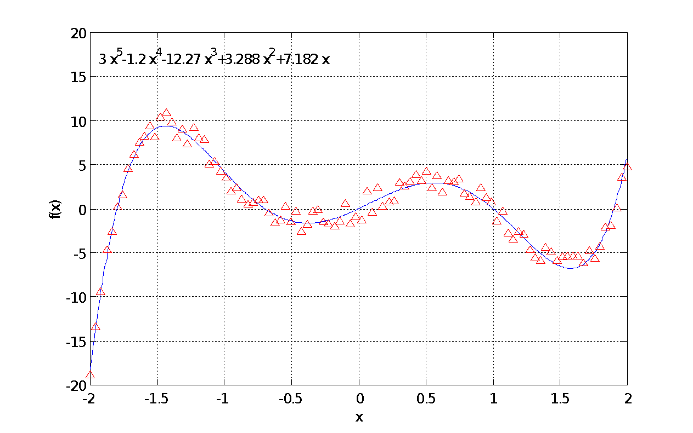
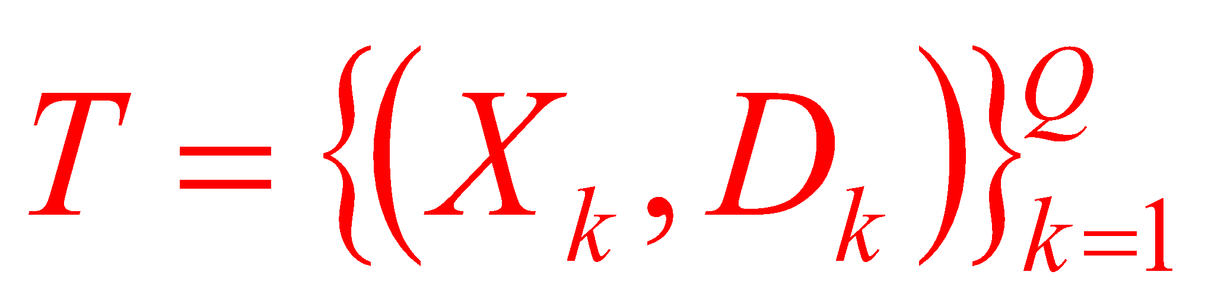
Supervised Learning(1/2)
Data comprises a set of discrete samples
drawn from the pattern space where each sample relates an input vector X_{k} ∈ R^{n} to an output vector D_{k} ∈ R^{p}.
An example function described
by a set of noisy data points

Slide 13
Supervised Learning(2/2)
The set of samples describe the behavior of an unknown function f : R^{n} → R^{p} which is to be characterized.
An example function described
by a set of noisy data points

Slide 14
The Supervised Learning Procedure
Error information fed back for network adaptation
X_{k}
S_{k}
Error
D_{x}
Neural Network
We want the system to generate an output D_{k} in response to an input X_{k}, and we say that the system has learnt the underlying map if a stimulus X_{k}’ close to X_{k} elicits a response S_{k}’ which is sufficiently close to D_{k}. The result is a continuous function estimate.

Slide 15
Unsupervised Learning(1/2)
Unsupervised learning provides the system with an input X_{k}, and allow it to self-organize its weights to generate internal prototypes of sample vectors. Note: There is no teaching input involved here.
The system attempts to represent the entire data set by employing a small number of prototypical vectors—enough to allow the system to retain a desired level of discrimination between samples.

Slide 16
Unsupervised Learning(2/2)
As new samples continuously buffer the system, the prototypes will be in a state of constant flux.
This kind of learning is often called adaptive vector quantization

Slide 17
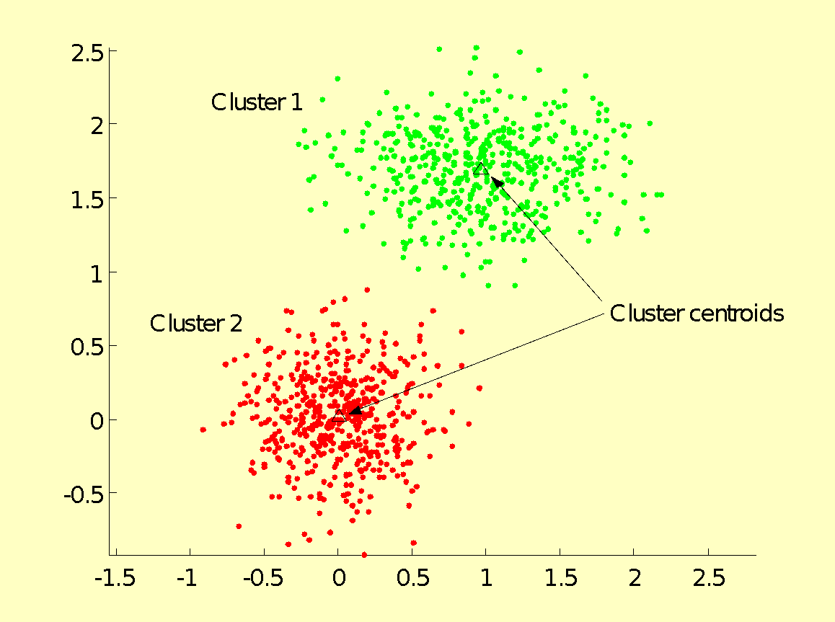
Clustering and Classification(1/3)
Given a set of data samples {X_{i}}, X_{i} ∈ R^{n}, is it possible to identify well defined “clusters”, where each cluster defines a class of vectors which are similar in some broad sense?

Slide 18
Clustering and Classification(2/3)
Clusters help establish a classification structure within a data set that has no categories defined in advance.
Classes are derived from clusters by appropriate labeling.

Slide 19
Clustering and Classification(3/3)
The goal of pattern classification is to assign an input pattern to one of a finite number of classes.
Quantization vectors are called codebook vectors.

Slide 20
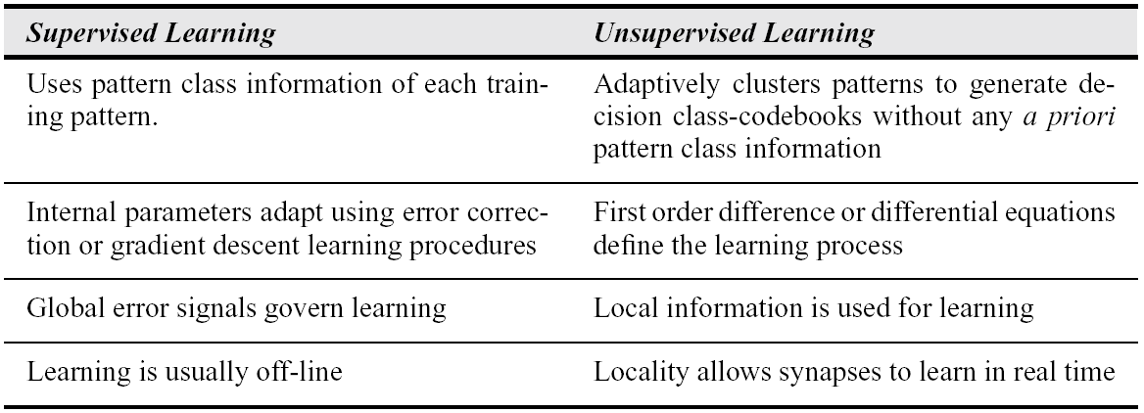
Characteristics of Supervised and Unsupervised Learning

Slide 21
General Philosophy of Learning: Principle of Minimal Disturbance
Adapt to reduce the output error for the current training pattern, with minimal disturbance to responses already learned.

Slide 22
Error Correction and Gradient Descent Rules
Error correction rules alter the weights of a network using a linear error measure to reduce the error in the output generated in response to the present input pattern.
Gradient rules alter the weights of a network during each pattern presentation by employing gradient information with the objective of reducing the mean squared error (usually averaged over all training patterns).

Slide 23
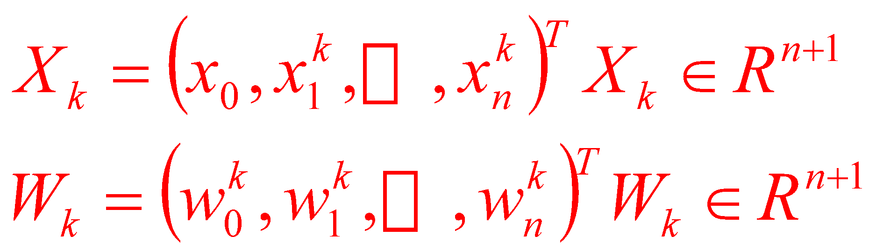
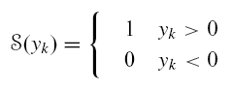
Learning Objective for TLNs(1/4)
+1
Augmented Input and Weight vectors
Objective: To design the weights of a TLN to correctly classify a given set of patterns.
X₁
W_{O}
W₁
W₂
Σ
X₂
S
…
W_{n}
X_{n}

Slide 24
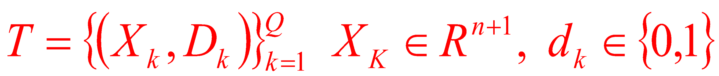
Learning Objective for TLNs(2/4)
Assumption: A training set of following form is given
Each pattern X_{k} is tagged to one of two classes C₀ or C₁ denoted by the desired output d_{k} being 0 or 1 respectively.
+1
X₁
W_{O}
W₁
W₂
Σ
X₂
S
…
W_{n}
X_{n}

Slide 25
Learning Objective for TLNs(3/4)
Two classes identified by two possible signal states of the TLN
C₀ by a signal S(y_{k}) = 0, C₁ by a signal S(y_{k}) = 1.
Given two sets of vectors X₀ andX₁ belonging to classes C₀ and C₁ respectively the learning procedure searches a solution weight vector W_{S} that correctly classifies the vectors into their respective classes.

Slide 26
Learning Objective for TLNs(4/4)
Context: TLNs
Find a weight vectorW_{S} such that for all X_{k} ∈ X₁, S(y_{k}) = 1; and for all X_{k} ∈ X₀, S(y_{k}) = 0.
Positive inner products translate to a +1 signal and negative inner products to a 0 signal
Translates to saying that for all X_{k} ∈ X₁, X_{k}^{T}W_{S} > 0; and for all X_{k} ∈ X₀, X_{k}^{T}W_{S} < 0.

Slide 27
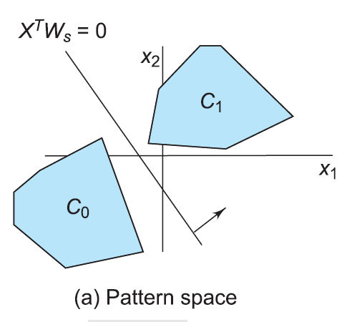
Pattern Space(1/2)
Activation
Points that satisfy X^{T}W_{S} = 0 define a separating hyperplane in pattern space.
Two dimensional case:
Pattern space points on one side of this hyperplane (with an orientation indicated by the arrow) yield positive inner products with W_{S} and thus generate a +1 neuron signal.

Slide 28
Pattern Space(2/2)
Activation
Two dimensional case:
Pattern space points on the other side of the hyperplane generate a negative inner product with W_{S} and consequently a neuron signal equal to 0.
Points in C₀ and C₁ are thus correctly classified by such a placement of the hyperplane.

Slide 29
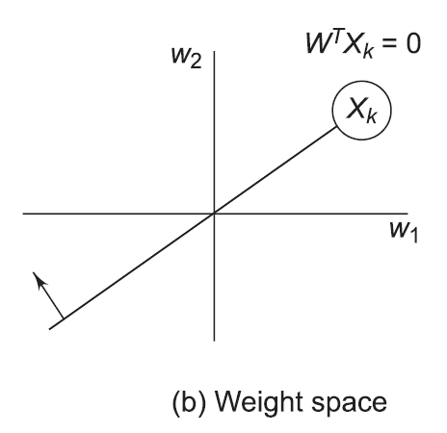
A Different View: Weight Space (1/2)
Weight vector is a variable vector.
W^{T}X_{k} = 0 represents a hyperplane in weight space
Always passes through the origin since W = 0 is a trivial solution of W^{T}X_{k} = 0.

Slide 30
A Different View: Weight Space (2/2)
Called the pattern hyperplane of pattern X_{k}.
Locus of all pointsW such thatW^{T}X_{k} = 0.
Divides the weight space into two parts: one which generates a positive inner product W^{T}X_{k} > 0, and the other a negative inner product W^{T}X_{k}<0.

Slide 31
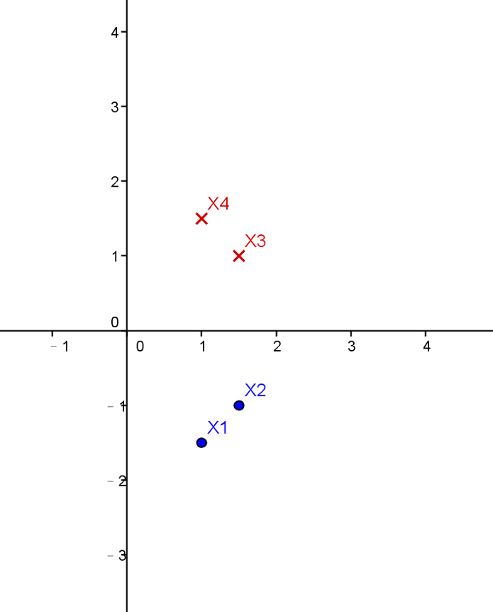
Example
X₁=(1, -1.5), X₂=(1.5, -1),
∈C₁
X₃=(1.5, 1), X₄=(1, 1.5) ∈C₀

Slide 32
Example
W₂
X₁=(1, -1.5) ∈C₁
(1, 2)
X₁
1*W₁-1.5*W₂=0
1*(W₁ =2) -1.5*(W₂=1)
= 0.5 > 0
(2, 1)
W₁
1*(W₁ =1) -1.5*(W₂=2)
= -2 < 0

Slide 33
Example
W₂
X₂
X₁=(1, -1.5) ∈C₁
X₂=(1.5, -1), ∈C₁
(1, 2)
X₁
1.5*W₁-1*W₂=0
1.5*(W₁ =2) -1*(W₂=1)
= 2 > 0
(2, 1)
W₁
1.5*(W₁ =1) -1*(W₂=2)
= -0.5 < 0

Slide 34
Identifying a Solution Region from Orientated Pattern Hyperplanes(1/2)
W₂
For each pattern X_{k} in pattern space there is a corresponding hyperplane in weight space.
For every point in weight space there is a corresponding hyperplane in pattern space.
X₃
X₂
X₁
W₁
X₄
Solution region

Slide 35
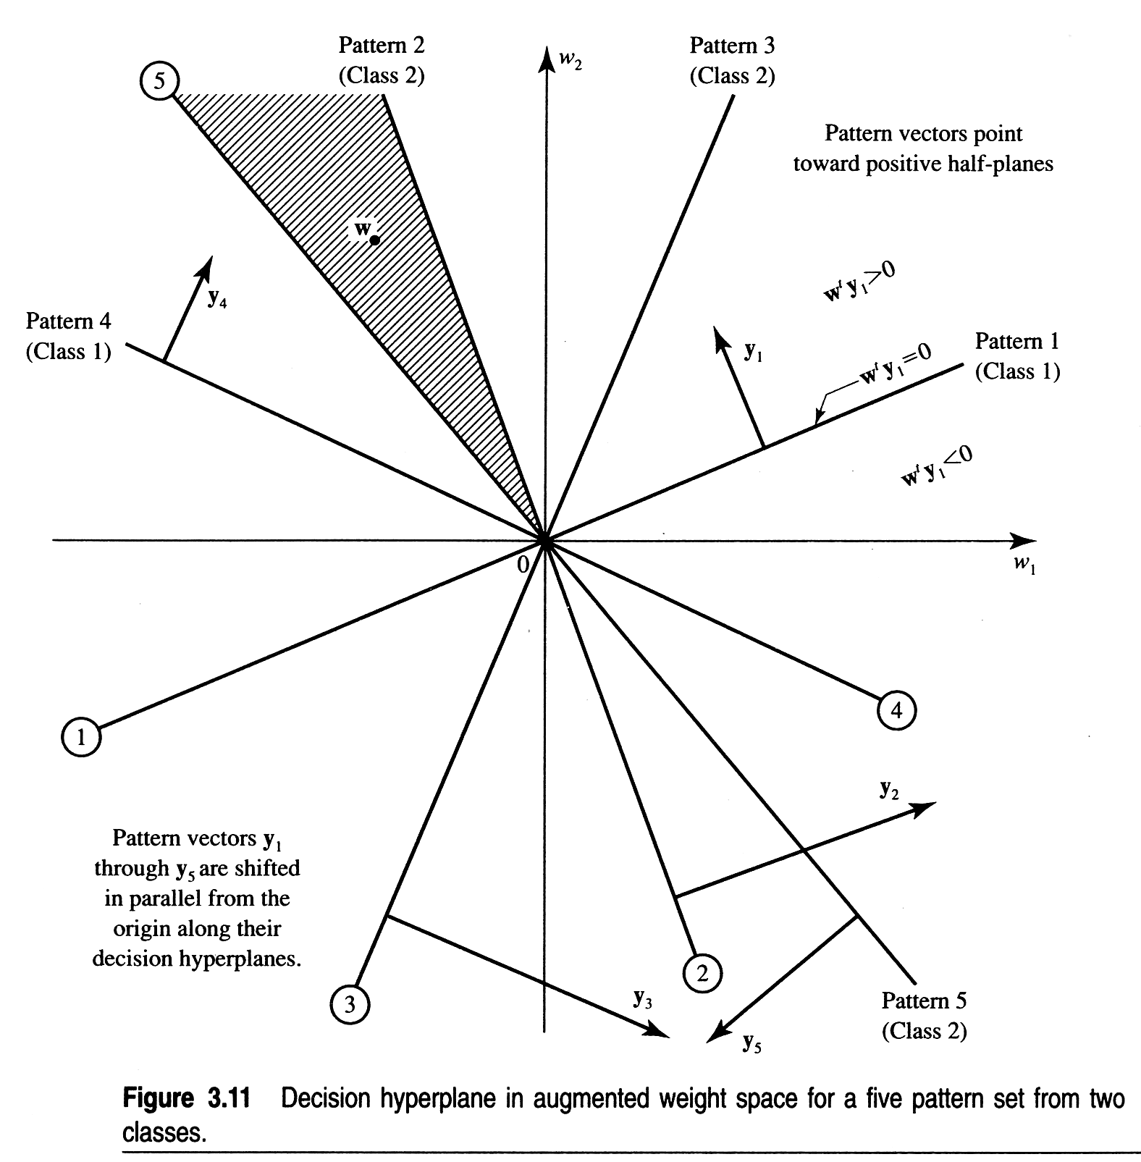
Identifying a Solution Region from Orientated Pattern Hyperplanes(2/2)
y1, y4∈class 1
y2, y3∈class 2

Slide 36
Requirements of the Learning Procedure
Linear separability guarantees the existence of a solution region.
Points to be kept in mind in the design of an automated weight update procedure :
It must consider each pattern in turn to assess the correctness of the present classification.
It must subsequently adjust the weight vector to eliminate a classification error, if any.
Since the set of all solution vectors forms a convex cone, the weight update procedure should terminate as soon as it penetrates the boundary of this cone (solution region).

Slide 37
Design in Weight Space(1/3)
Assume: X_{k} ∈ X₁ and W_{k}^{T}X_{k} as erroneously non-positive.
For correct classification, shift the weight vector to some position W_{k+1} where the inner product is positive.
X_{k}
W_{k+1}
W_{k}^{T} X_{k}>0
W_{k}
W^{T} X_{k}<0

Slide 38
Design in Weight Space(2/3)
X_{k}
The smallest perturbation in W_{k} that produces the desired change is, the perpendicular distance from W_{k} onto the pattern hyperplane.
W_{k+1}
W_{k}^{T} X_{k}>0
W_{k}
W^{T} X_{k}<0

Slide 39
Design in Weight Space(3/3)
In weight space, the direction perpendicular to the pattern hyperplane is none other than that of X_{k} itself.
X_{k}
W_{k+1}
W_{k}^{T} X_{k}>0
W_{k}
W^{T} X_{k}<0

Slide 40
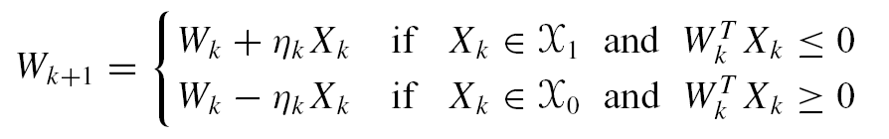
Simple Weight Change Rule: Perceptron Learning Law
If X_{k} ∈ X₁ and W_{k}^{T}X_{k} < 0 add a fraction of the pattern to the weight W_{k} if one wishes the inner product W_{k}^{T}X_{k} to increase.
Alternatively, if X_{k} ∈ X₀, and W_{k}^{T}X_{k} is erroneously non-negative we will subtract a fraction of the pattern from the weight W_{k} in order to reduce this inner product.

Slide 41
Weight Space Trajectory
W₂
The weight space trajectory corresponding to the sequential presentation of four patterns with pattern hyperplanes as indicated:
χ₁ = {X₁,X₂} and χ₀ = {X₃,X₄}
X₃
X₂
X₁
W₁
X₄
Solution region

Slide 42
Linear Containment
Consider the set X₀’ in which each element X₀ is negated.
Given a weight vectorW_{k}, for any X_{k} ∈ X₁ ∪ X₀’, X_{k}^{T} W_{k} > 0 implies correct classification and X_{k}^{T}W_{k} < 0 implies incorrect classification.
X‘ = X₁ ∪ X₀’ is called the adjusted training set.
Assumption of linear separability guarantees the existence of a solution weight vector W_{S}, such that X_{k}^{T}W_{S} > 0 ∀ X_{k} ∈ X
We say X’ is a linearly contained set.

Slide 43
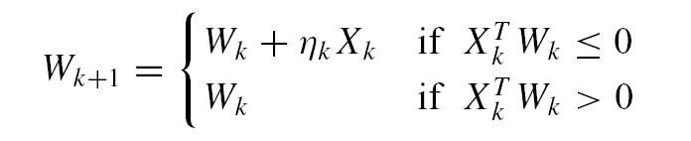
Recast of Perceptron Learning with Linearly Contained Data
Since X_{k} ∈ X’, a misclassification of X_{k} will add η_{k}X_{k} to W_{k}.
ForX_{k} ∈ X₀‘, X_{k} actually represents the negative of the original vector.
Therefore addition of η_{k}X_{k} to W_{k} actually amounts to subtraction of the original vector from W_{k}.

Slide 44
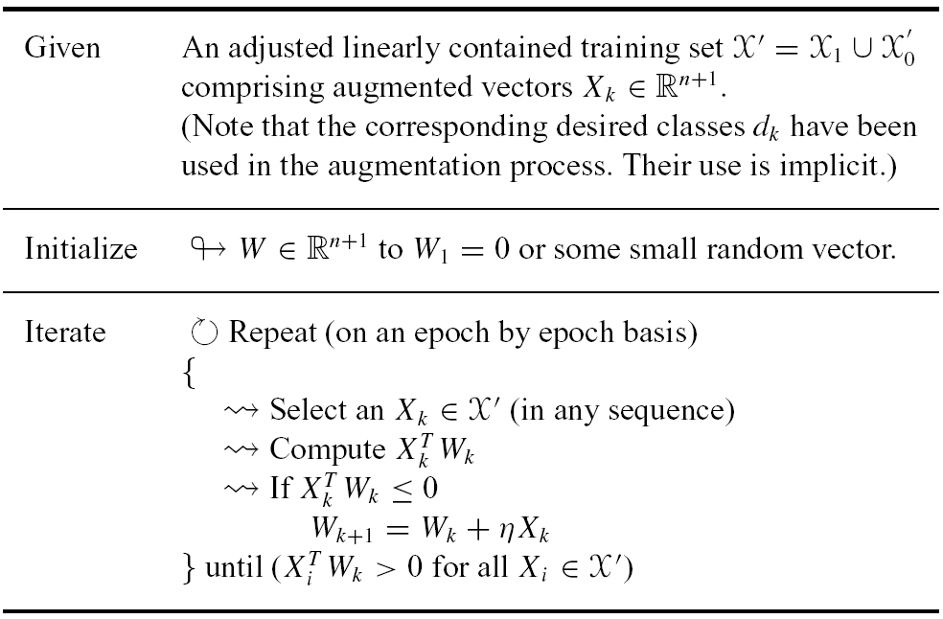
Perceptron Algorithm: Operational Summary

Slide 45
Perceptron Convergence Theorem
Given: A linearly contained training set X’ and any initial weight vectorW₁.
Let S_{W} be the weight vector sequence generated in response to presentation of a training sequence S_{X} upon application of Perceptron learning law. Then for some finite index k₀ we have: W_{k0} = W_{k0}+1 = W_{k0}+2 = ・ ・ ・ = W_{S} as a solution vector.
See the text for detailed proofs.

Slide 46
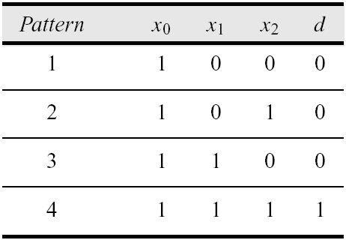
Hand-worked Example
+1
X₁
W_{O}
W₁
S
W₂
X₂
Binary threshold neuron

Slide 47
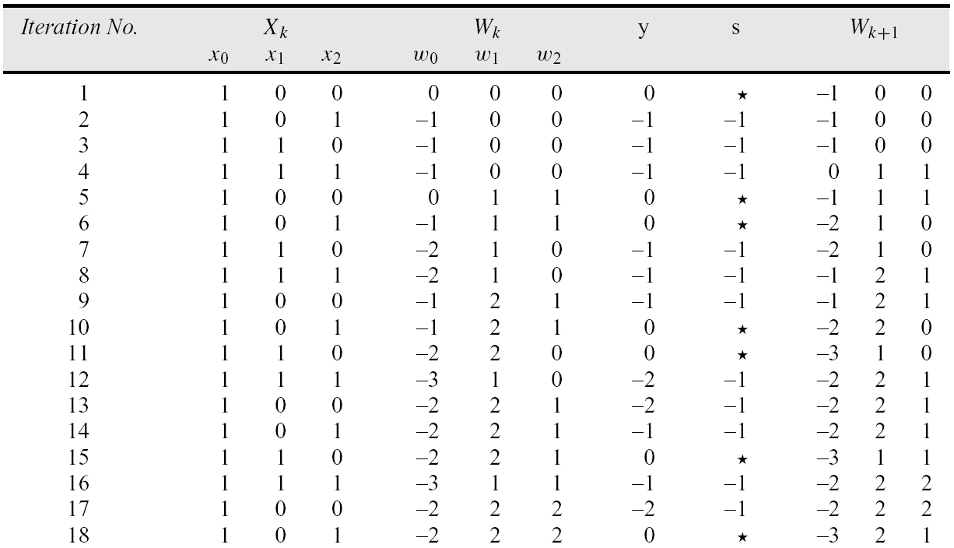
Classroom Exercise(1/2)

Slide 48
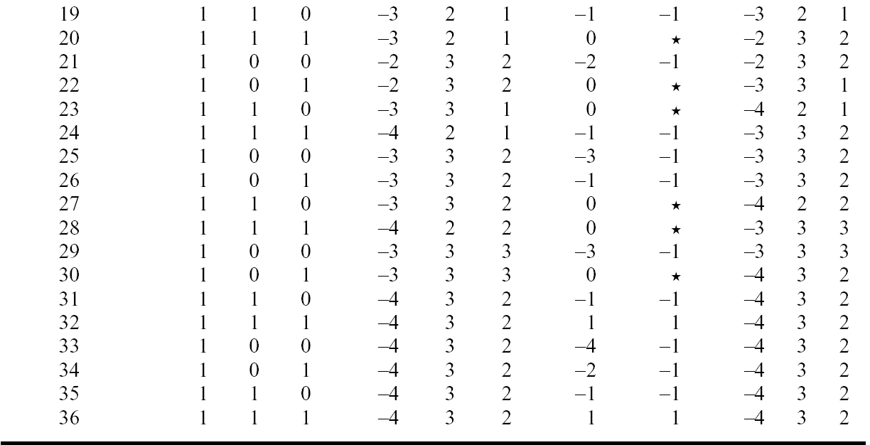
Classroom Exercise(2/2)

Slide 49
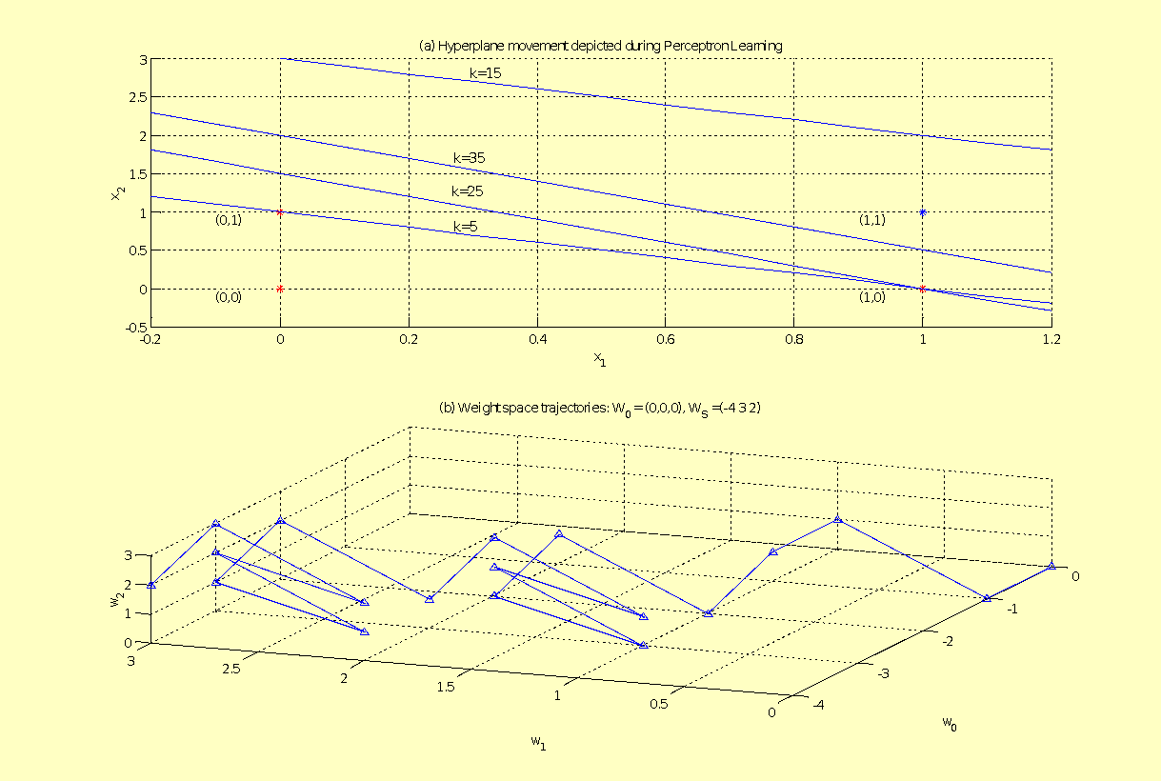
MATLAB Simulation

Slide 50
Perceptron Learning and Non-separable Sets
Theorem:
Given a finite set of training patterns X, there exists a number M such that if we run the Perceptron learning algorithm beginning with any initial set of weights,W₁, then any weight vector W_{k} produced in the course of the algorithm will satisfyW_{k} ≤ W₁ +M

Slide 51
Two Corollaries(1/2)
If, in a finite set of training patterns X, each pattern X_{k} has integer (or rational) components x_{i}^{k}, then the Perceptron learning algorithm will visit a finite set of distinct weight vectors W_{k}.

Slide 52
Two Corollaries(2/2)
For a finite set of training patterns X, with individual patterns X_{k} having integer (or rational) components x_{i}^{k} the Perceptron learning algorithm will, in finite time, produce a weight vector that correctly classifies all training patterns iff X is linearly separable, or leave and re-visit a specific weight vector iff X is linearly non-separable.

Slide 53
Handling Linearly Non-separable Sets: The Pocket Algorithm(1/2)
Philosophy: Incorporate positive reinforcement in a way to reward weights that yield a low error solution.
Pocket algorithm works by remembering the weight vector that yields the largest number of correct classifications on a consecutive run.

Slide 54
Handling Linearly Non-separable Sets: The Pocket Algorithm(2/2)
This weight vector is kept in the “pocket”, and we denote it as W_{pocket} .
While updating the weights in accordance with Perceptron learning, if a weight vector is discovered that has a longer run of consecutively correct classifications than the one in the pocket, it replaces the weight vector in the pocket.

Slide 55
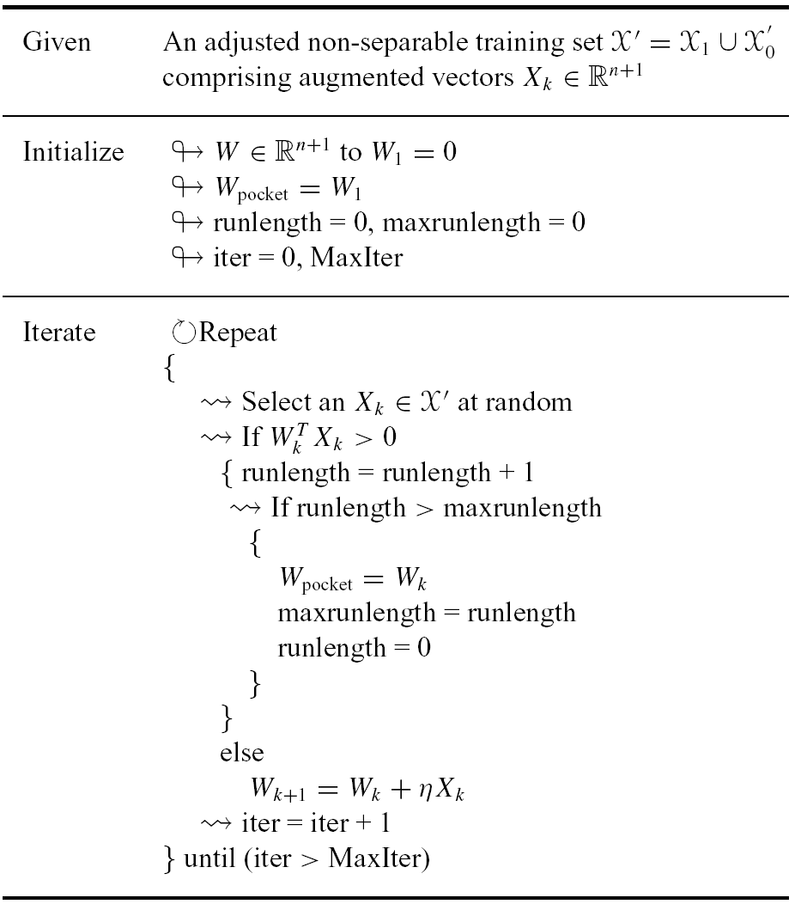
Pocket Algorithm: Operational Summary(1/2)

Slide 56
Pocket Algorithm: Operational Summary(2/2)

Slide 57
Pocket Convergence Theorem
Given a finite set of training examples, X, and a probabilityp < 1, there exists an integer k₀ such that after any k > k₀ iterations of the pocket algorithm, the probability that the pocket weight vectorW_{pocket} is optimal exceeds p.

Slide 58
Linear Neurons and Linear Error
Consider a training set of the form T = {X_{k}, d_{k}}, X_{k} ∈ R^{n+1}, d_{k} ∈ R.
To allow the desired output to vary smoothly or continuously over some interval consider a linear signal function: s_{k} = y_{k} = X_{k}^{T}W_{k}
The linear error e_{k} due to a presented training pair (X_{k}, d_{k}), is the difference between the desired output d_{k} andthe neuronal signal s_{k}: e_{k} = d_{k} − s_{k} = d_{k} − X_{k}^{T}W_{k}

Slide 59
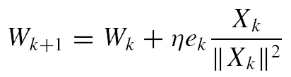
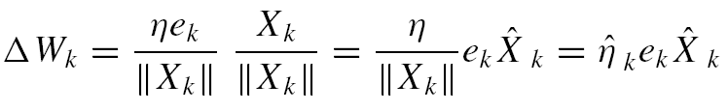
Operational Details of α–LMS
+1
α–LMS error correction is proportional to the error itself
Each iteration reduces the error by a factor of η.
η controls the stability and speed of convergence.
Stability ensured
if 0 < η < 2.
X₁^{k}
W_{O}
W₁^{k}
X₂^{k}
W₂^{k}
S_{k}=X_{k}^{T}W_{k}
…
W_{n}^{k}
X_{n}^{k}

Slide 60
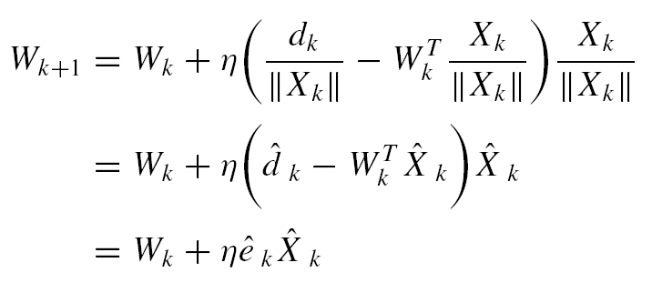
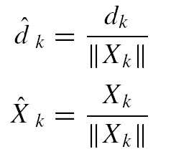
α–LMS Works with Normalized Training Patterns
x₃
x_{k}
W_{k+1}
W_{k}
W_{k}
x₂
x₁

Slide 61
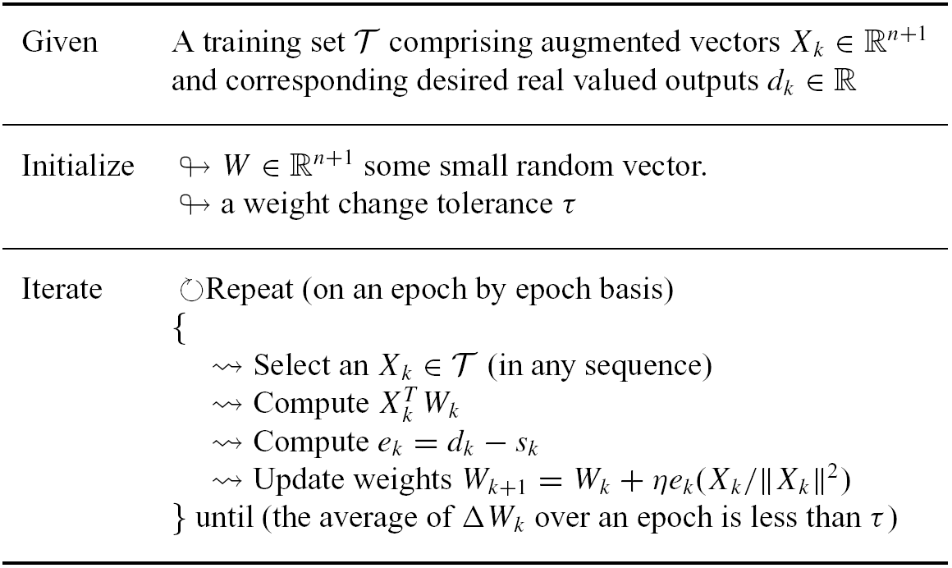
α–LMS: Operational Summary

Slide 62
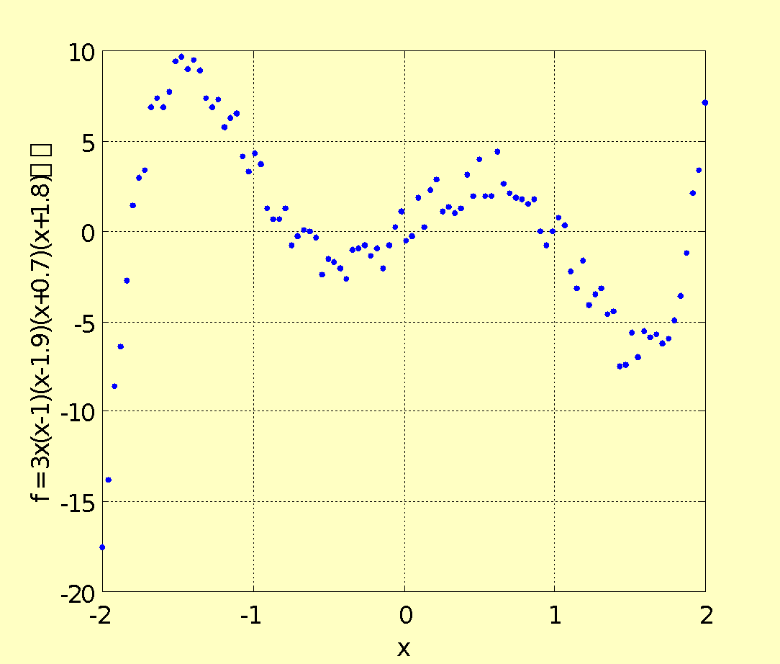
MATLAB Simulation Example
Synthetic data set shown in the figure is generated by artificially scattering points around a straight line: y = 0.5x + 0.333 and generate a scatter of 200 points in a ±0.1 interval in the y direction.

Slide 63
MATLAB Simulation Example
This is achieved by first generating a random scatter in the interval [0,1].
Then stretching it to the interval [−1, 1], and finally scaling it to ±0.1

Slide 64
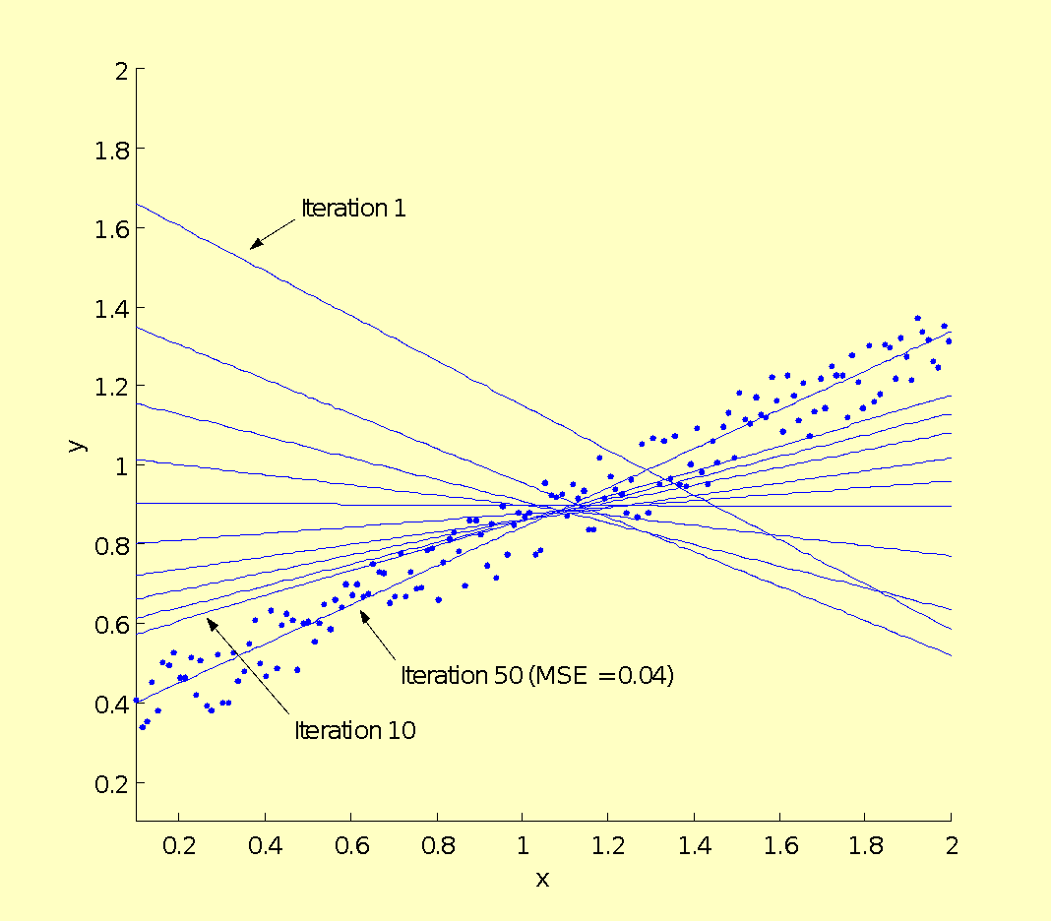
Computer Simulation of α-LMS Algorithm

Slide 65
A Stochastic Setting
Assumption that the training set T is well defined in advance is incorrect when the setting is stochastic.
In such a situation, instead of deterministic patterns, we have a sequence of samples {(X_{k}, d_{k})} assumed to be drawn from a statistically stationary population or process.
For adjustment of the neuron weights in response to some pattern-dependent error measure, the error computation has to be based on the expectation of the error over the ensemble.

Slide 66
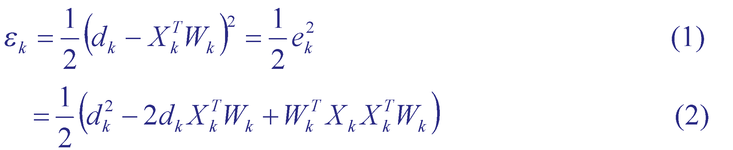
Definition of Mean Squared Error (MSE)(1/2)
We introduce the square error on a pattern X_{k} as
Assumption: The weights are held fixed at W_{k} while computing the expectation.

Slide 67
Definition of Mean Squared Error (MSE)(2/2)
The mean-squared error can now be computed by taking the expectation on both sides of (2):

Slide 68
Our problem…
To find optimal weight vector that minimizes the mean-square error.

Slide 69
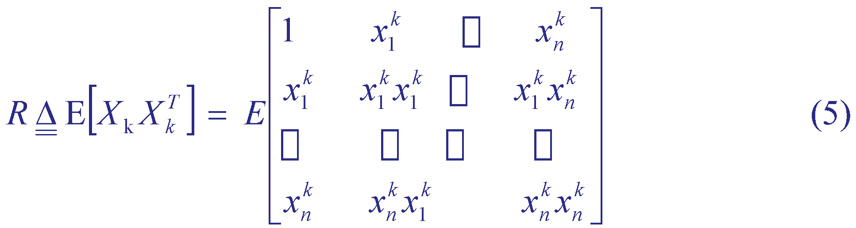
Cross Correlations(1/2)
For convenience of expression we define the pattern vector P as the cross-correlation between the desired scalar output, d_{k}, and the input vector, X_{k}
and the input correlation matrix, R, as

Slide 70
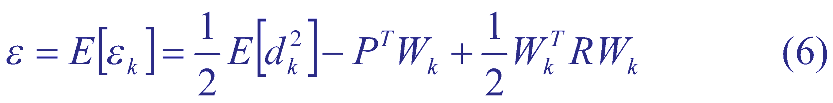
Cross Correlations (2/2)
Using Eqns. (4)-(5), we rewrite the MSE expression of Eqn. (3) succinctly as
Note that since the MSE is a quadratic function of the weights it represents a bowl shaped surface in the (n+1) x 1 weight—MSE cross space.

Slide 71
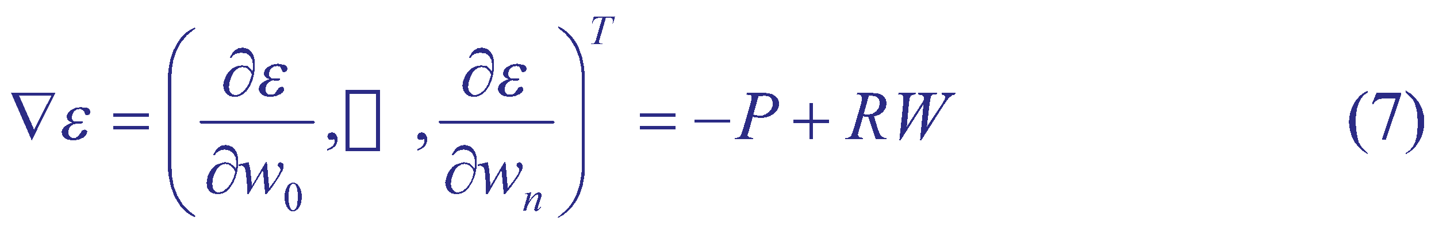


Finding the Minimum Error(1/2)
First compute the gradient by straightforward differentiation which is a linear function of weights
To find the optimal set of weights, , simply set
which yields

Slide 72

Finding the Minimum Error (2/2)
This system of equations (8) is called the Weiner-Hopf system and its solution is the Weiner solution or the Weiner filter
is the point in weight space that represents the minimum mean-square error

Slide 73


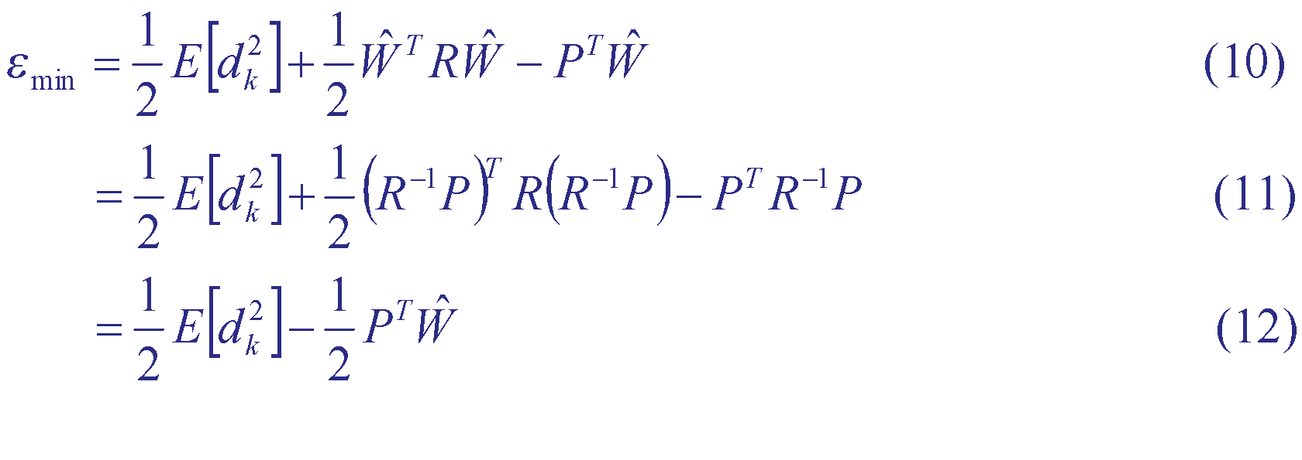
Computing the Optimal Filter(1/2)
First compute and . Substituting from Eqn. (9) into Eqn. (6) yields:

Slide 74
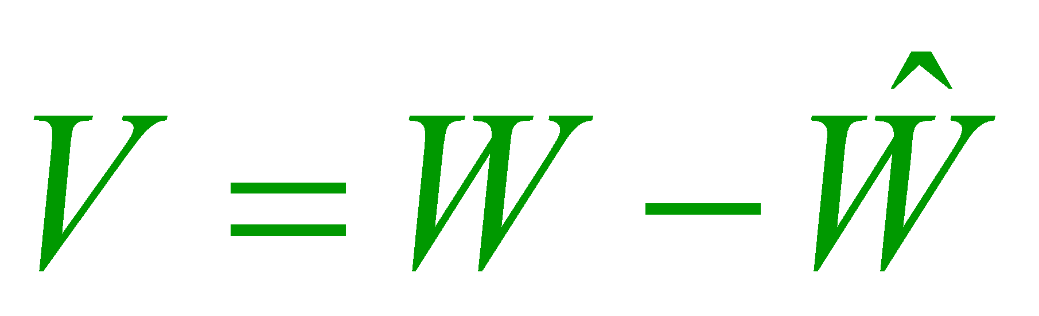
Computing the Optimal Filter(2/2)
For the treatment of weight update procedures we reformulate the expression for mean-square error in terms of the deviation , of the weight vector from the Weiner solution.

Slide 75
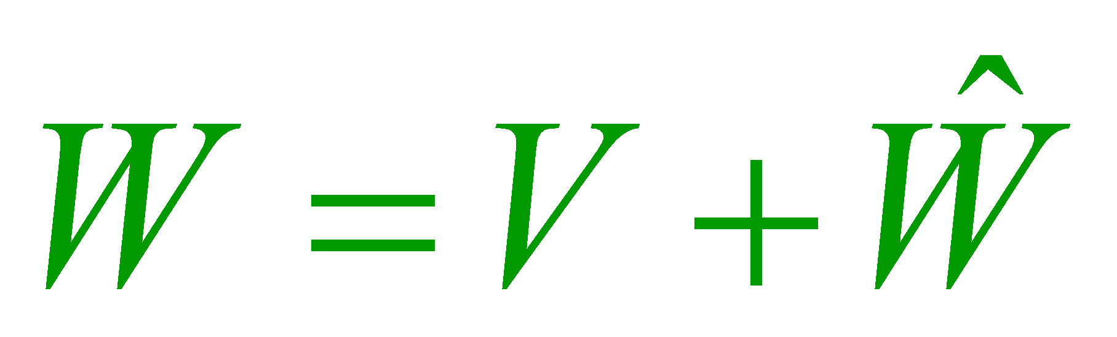
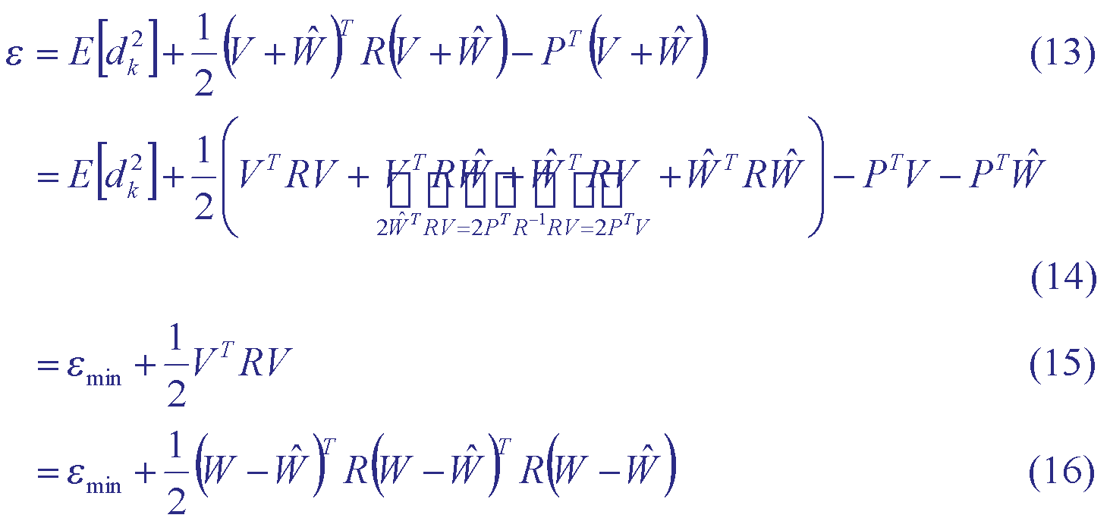
Computing R(1/2)
Substituting into Eqn. (6)

Slide 76


Computing R(2/2)
Note that since the mean-square error is non-negative, we must have . This implies that R is positive semi-definite. Usually however, R is positive definite.

Slide 77

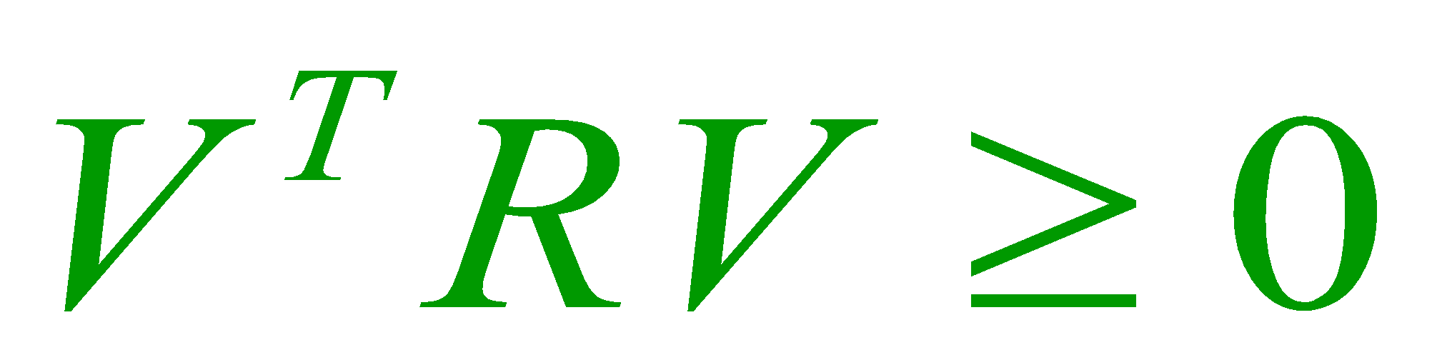
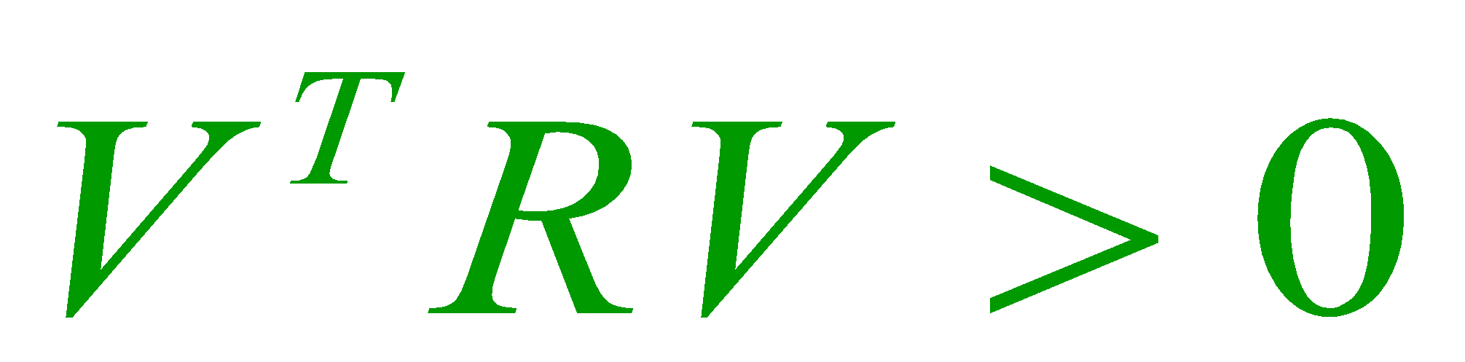
Property of matrix
A symmetric matrix R and the quadratic form are called
positive semidefinite if
positive definite if
We guarantee that all eigen values of R are positive and for all V ≠0

Slide 78



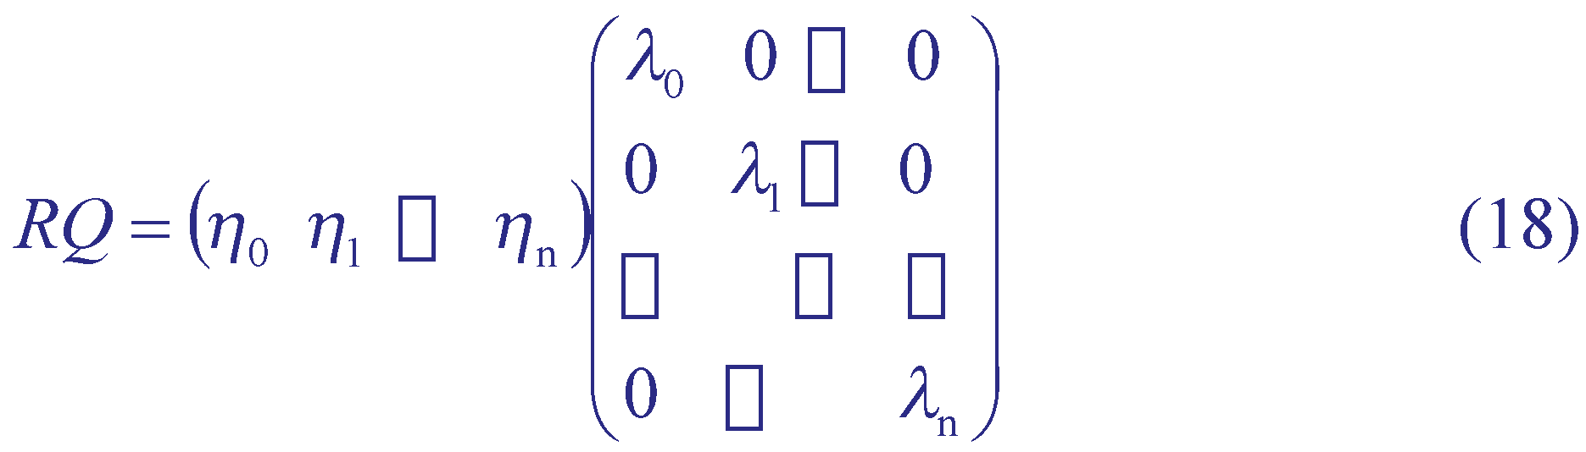
Diagonalization of R
Assume that R has distinct eigenvalues . Then we can construct a matrix Q whose columns are corresponding eigenvectors of R.
R can be diagonalized using an orthogonal similarity transformation as follows. Having constructed Q, and knowing that:
We have

Slide 79
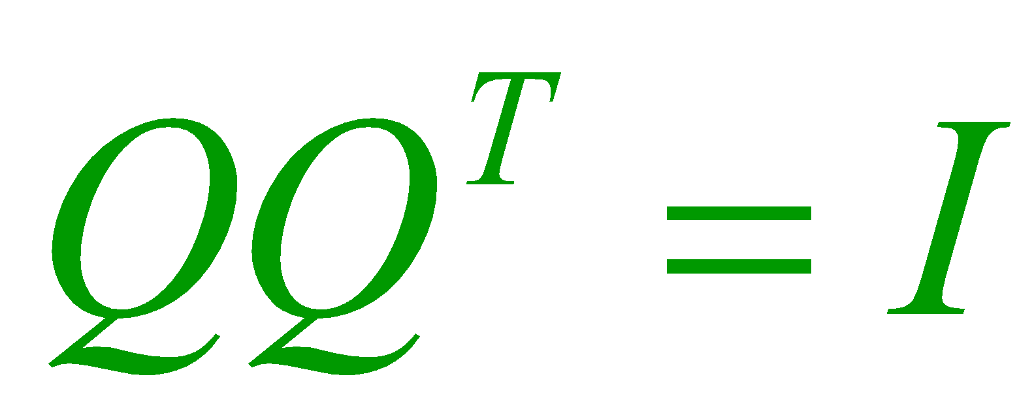

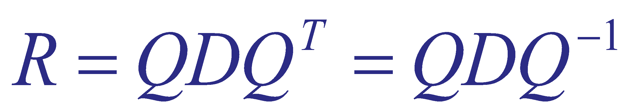


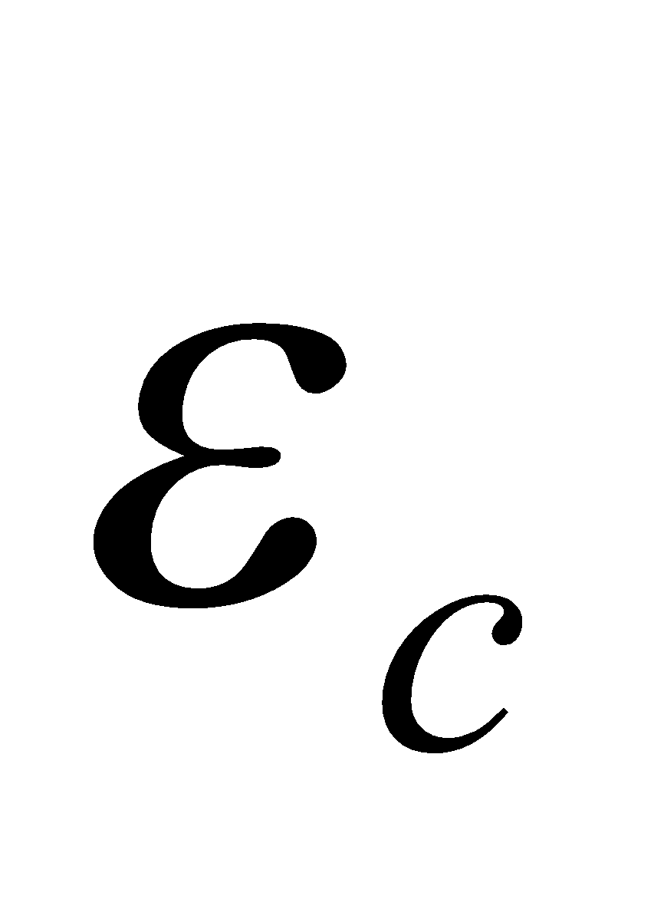
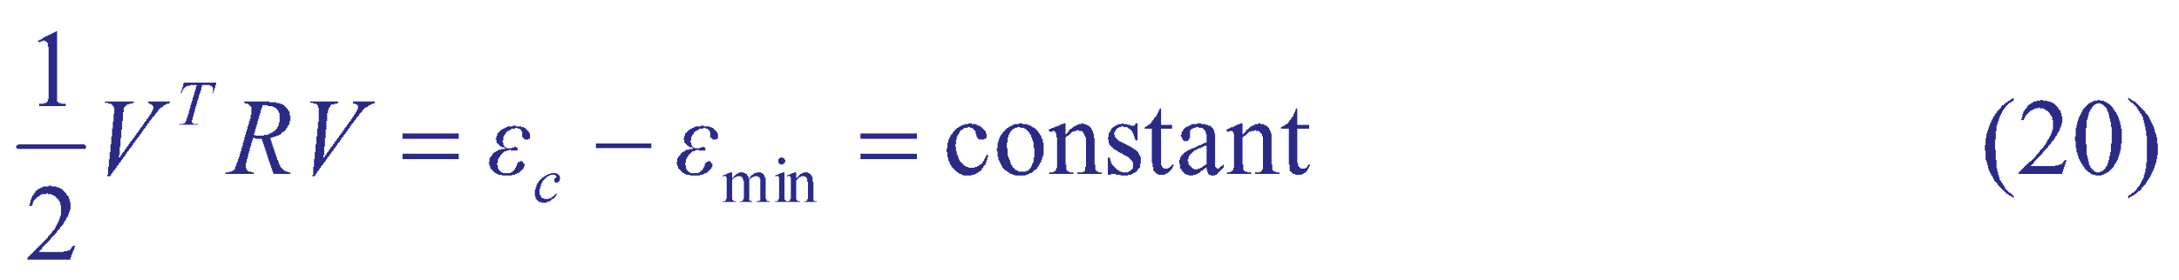
Some Observations
It is usual to choose the eigenvectors of R to be orthonormal and .
Then
From Eqn. (15) we know that the shape of is a bowl-shaped paraboloid with a minimum at the Weiner solution (V=0, the origin of V-space).
Slices of parallel to the W space yield elliptic constant error contours which define the weights in weight space that the specific value of the square-error (say ) at which the slice is made:

Slide 80

Eigenvectors of R(1/2)
Also note from Eqn. (15) that we can compute the MSE gradient in V-space as,
which defines a family of vectors in V-space.
Exactly n+1 of these pass through the origin of V-space and these are the principal axes of the ellipse.

Slide 81

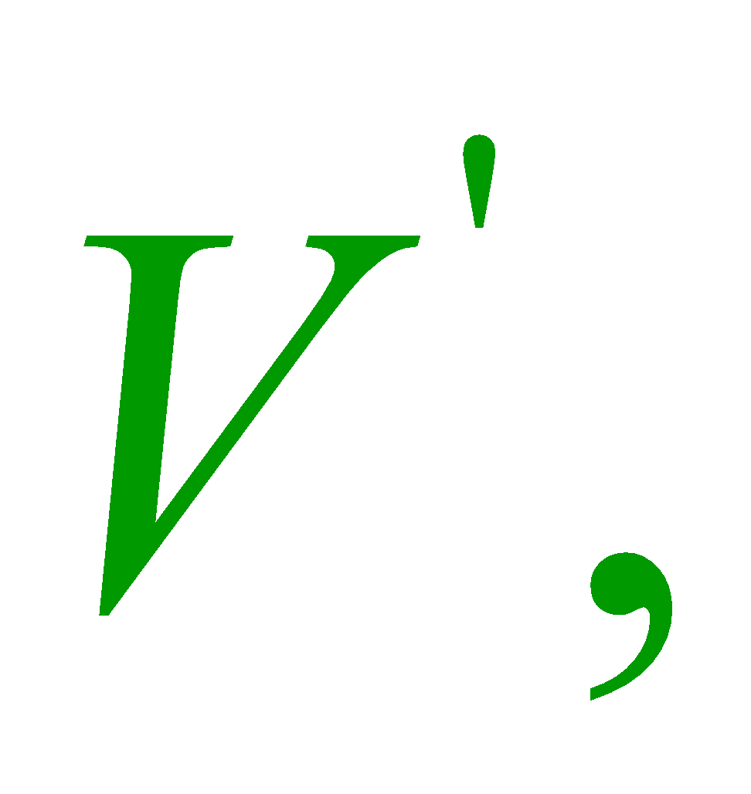
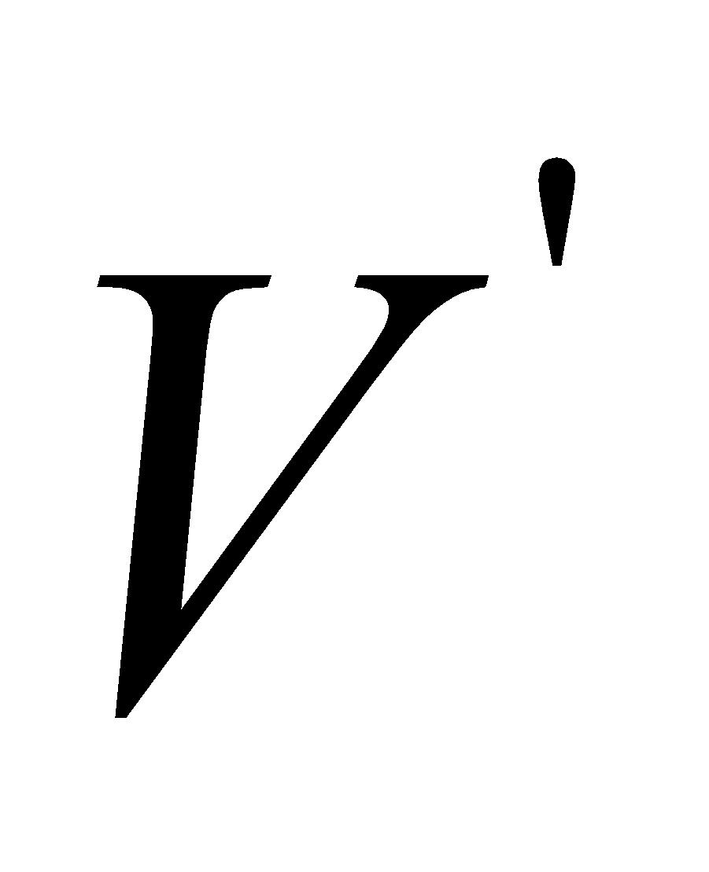
Eigenvectors of R(2/2)
However, vectors passing through the origin must take the . Therefore, for the principal axes
Clearly, is an eigenvector of R.

Slide 82
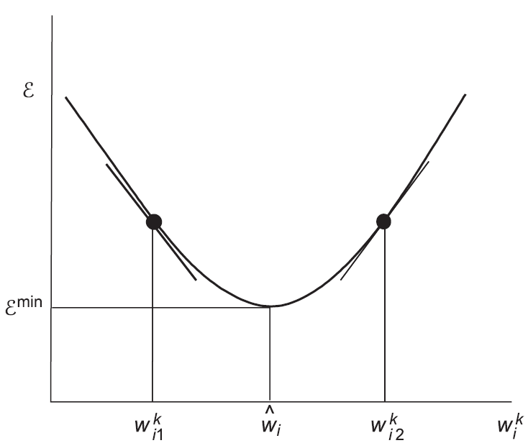
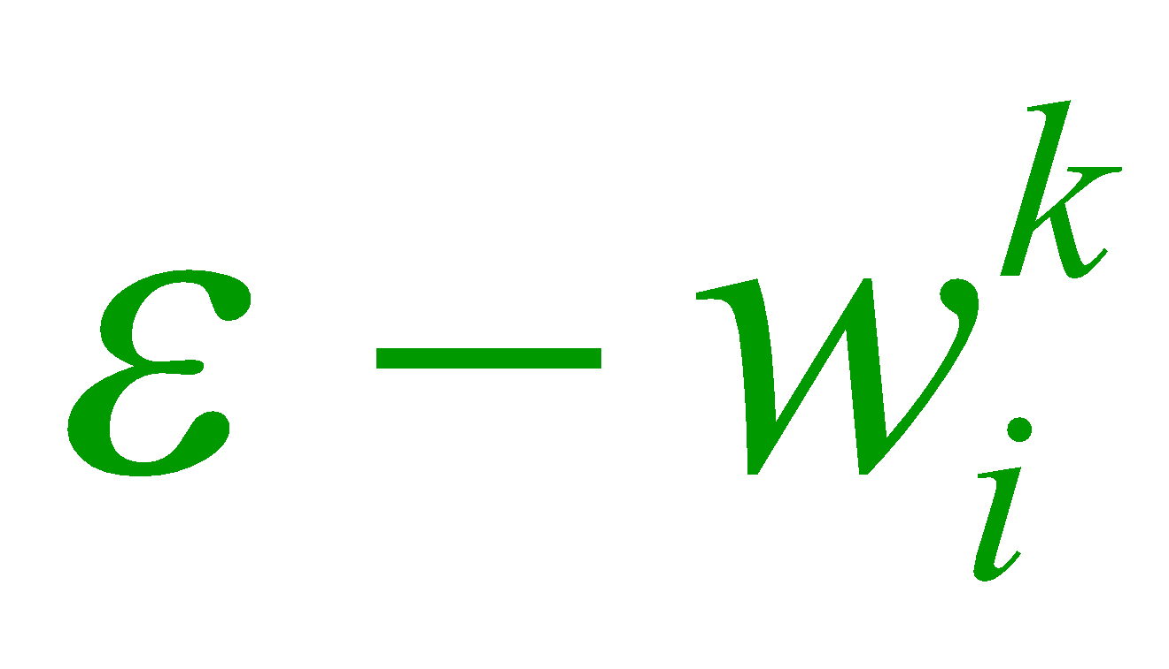
Steepest Descent Search with Exact Gradient Information
Steepest descent search uses exact gradient information available from the mean-square error surface to direct the search in weight space.
The figure shows a projection of the square-error function on the plane.

Slide 83




Steepest Descent Procedure Summary(1/2)
Provide an appropriate weight increment to to push the error towards the minimum which occurs at .
Perturb the weight in a direction that depends on which side of the optimal weight the current weight value lies.
If the weight component lies to the left of , say at , where the error gradient is negative (as indicated by the tangent) we need to increase .

Slide 84

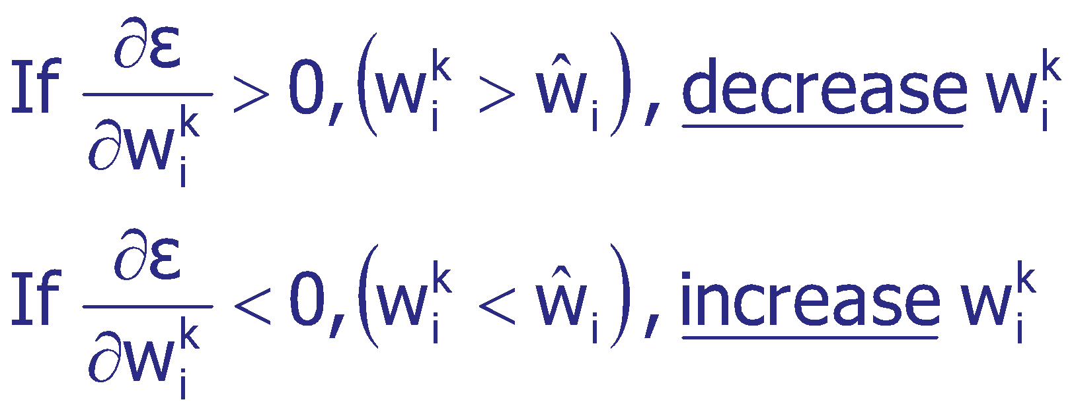
Steepest Descent Procedure Summary(2/2)
If is on the right of , say at where the error gradient is positive, we need to decrease .
This rule is summarized in the following statement:

Slide 85
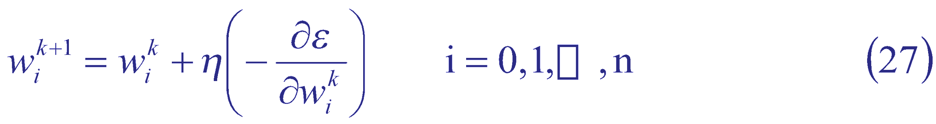
Weight Update Procedure(1/3)
It follows logically therefore, that the weight component should be updated in proportion with the negative of the gradient:

Slide 86
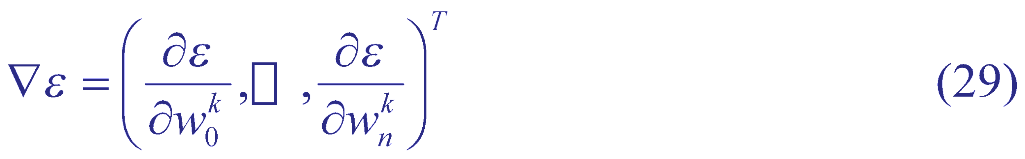
Weight Update Procedure(2/3)
Vectorially we may write
where we now re-introduced the iteration time dependence into the weight components:

Slide 87
Weight Update Procedure(3/3)
Equation (28) is the steepest descent update procedure. Note that steepest descent uses exact gradient information at each step to decide weight changes.

Slide 88

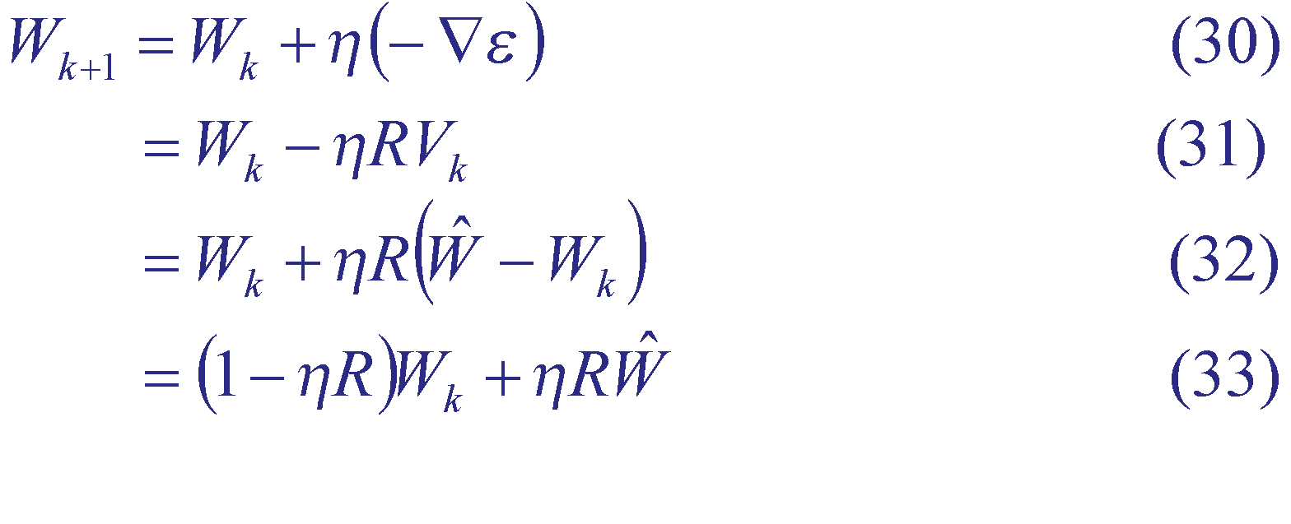
Convergence of Steepest Descent – 1(1/2)
Question: What can one say about the stability of the algorithm? Does it converge for all values of ?
To answer this question consider the following series of subtitutions and transformations. From Eqns. (28) and (21)

Slide 89
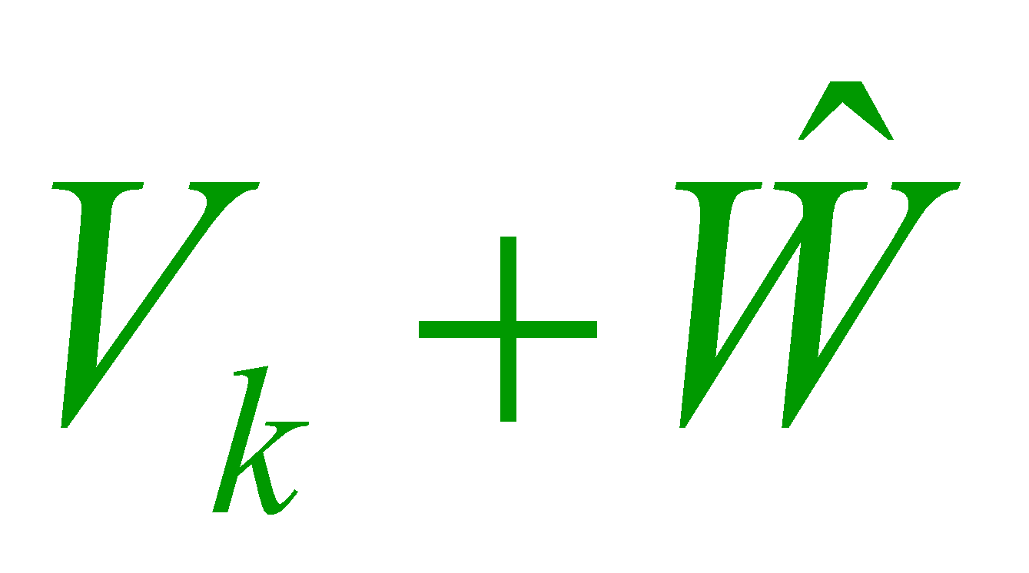

Convergence of Steepest Descent – 1(2/2)
Transforming Eqn. (33) into V-space (the principal coordinate system) by substitution of for yields:

Slide 90


Steepest Descent Convergence – 2(1/2)
Rotation to the principal axes of the elliptic contours can be effected by using :
or

Slide 91

Steepest Descent Convergence – 2(2/2)
where D is the diagonal eigenvalue matrix. Recursive application of
Eqn. (37) yields:
It follows from this that for stability and convergence of the algorithm:
or

Slide 92


Steepest Descent Convergence – 3(1/2)
This requires that
being the largest eigenvalue of R.
or

Slide 93

Steepest Descent Convergence – 3(2/2)
If this condition is satisfied then we have
Steepest descent is guaranteed to converge to the Weiner solution as long as the learning rate is maintained within the limits defined by Eqn. (41).
or

Slide 94

Computer Simulation Example(1/2)
This simulation example employs the fifth order function data scatter with the data shifted in the y direction by 0.5. Consequently, the values of R,P and the Weiner solution are respectively:

Slide 95
Computer Simulation Example(2/2)
Exact gradient information is available since the correlation matrix R and the cross-correlation matrix P are known.
The weights are updated using the equation:

Slide 96
MATLAB Simulation Example(1/3)
eta = .01; % Set learning rate
R=zeros(2,2); % Initialize correlation matrix
X = [ones(1,max_points);x]; % Augment input vectors
P = (sum([d.*X(1,:); d.*X(2,:)],2))/max_points; % Cross-correlations
D = (sum(d.^2))/max_points; %squares; % target expectations
for k =1:max_points
R = R + X(:,k)*X(:,k)'; % Compute R
end
R = R/max_points;
weiner=inv(R)*P; % Compute the Weiner solution
errormin = D - P'*inv(R)*P; % Find the minimum error

Slide 97
MATLAB Simulation Example (2/3)
shift1 = linspace(-12,12, 21); % Generate a weight space matrix
shift2 = linspace(-9,9, 21);
for i = 1:21 % Compute a weight matrix about
shiftwts(1,i) = weiner(1)+shift1(i); % Weiner solution
shiftwts(2,i) = weiner(2)+shift2(i);
end
for i=1:21 % Compute the error matrix
for j = 1:21 % to plot the error contours
error(i,j) = sum((d - (shiftwts(1,i) + x.*shiftwts(2,j))).^2);
end
end
error = error/max_points;
figure; hold on; % Plot the error contours
plot(weiner(1),weiner(2),'*k') % Labelling statements no shown

Slide 98
MATLAB Simulation Example (3/3)
w = 10*(2*rand(2,1)-1); % Randomize weights
w0 = w; % Remember the initial weights
for loop = 1:500 % Perform descent for 500 iters
w = w + eta*(-2*(R*w-P));
wts1(loop)=w(1); wts2(loop)=w(2);
End
% Set up weights for plotting
wts1=[w0(1) wts1]; wts2=[w0(2) wts2];
plot(wts1,wts2,'r') % Plot the weight trajectory

Slide 99


Smooth Trajectory towards the Weiner Solution
Steepest descent uses exact gradient information to search the Weiner solution in weight space.

Slide 100

μ-LMS: Approximate Gradient Descent(1/2)
The problem with steepest descent is that true gradient information is only available in situations where the data set is completely specified in advance.
It is then possible to compute R and P exactly, and thus the true gradient at iteration

Slide 101
μ-LMS: Approximate Gradient Descent(2/2)
However, when the data set comprises a random stream of patterns (drawn from a stationary distribution), R and P cannot be computed accurately. To find a correct approximation one might have to examine the data stream for a reasonably large period of time and keep averaging out.
How long should we examine the stream to get reliable estimates of R and P ?

Slide 102
Definition
The μ-LMS algorithm is convergent in the mean if the average of the weight vector W_{k} approaches the optimal solution W_{opt} as the number of iterations k, approaches infinity:
E[W_{k}] → W_{opt} as k → ∞

Slide 103




μ-LMS employs ε_{k} for ε=Ε[ε_{k}](1/2)
The gradient computation modifies to:
where , and since we are dealing with linear neurons. Note therefore that the recursive update equation then becomes

Slide 104


μ-LMS employs ε_{k} for ε=Ε[ε_{k}](2/2)
What value does the long term average of converge to? Taking the Expectation of both sides of Eqn. (47):

Slide 105



Observations(1/8)
Since the long term average of approaches , we can safely use as an unbiased estimate. That’s what makes μ-LMS work!
Since approaches in the long run, one could keep collecting for a sufficiently large number of iterations (while keeping the weights fixed), and then make a weight change collectively for all those iterations together.

Slide 106
Observations(2/8)
If the data set is finite (deterministic), then one can compute accurately by first collecting the different gradients over all training patterns for the same set of weights. This accurate measure of the gradient could then be used to change the weights. In this situation μ-LMS is identical to the steepest descent algorithm.

Slide 107


Observations(3/8)
Even if the data set is deterministic, we still use to update the weights. After all if the data set becomes large, collection of all the gradients becomes expensive in terms of storage. Much easier to just go ahead and use
Be clear about the approximation made: we are estimating the true gradient (which should be computed from ) by a gradient computed from the instantaneous sample error . Although this may seem to be a rather drastic approximation, it works.

Slide 108
Observations(4/8)
In the deterministic case we can justify this as follows: if the learning rate , is kept small, the weight change in each iteration will be small and consequently the weight vector W will remain “somewhat constant” over Q iterations where Q is the number of patterns in the training set.

Slide 109



Observations(5/8)
Of course this is provided that Q is a small number! To see this, observe the total weight change , over Q iterations from the iteration:

Slide 110

Observations(6/8)
Where denotes the mean-square error. Thus the weight updates follow the true gradient on average.

Slide 111

Observations(7/8)
Observe that steepest descent search is guaranteed to search the Weiner solution provided the learning rate condition (41) is satisfied.
Now since is an unbiased estimate of one can expect that μ-LMS too will search out the Weiner solution. Indeed it does—but not smoothly. This is to be expected since we are only using an estimate of the true gradient for immediate use.

Slide 112
Observations(8/8)
Although α-LMS and μ- LMS are similar algorithms, α-LMS works on the normalizing training set. What this simply means is that α-LMS also uses gradient information, and will eventually search out the Weiner solution-of the normalized training set. However, in one case the two algorithms are identical: the case when input vectors are bipolar. (Why?)

Slide 113




μ-LMS Algorithm: Convergence in the Mean (1)(1/2)
Definition 0.1 The -LMS algorithm is convergent in the mean if the average of the weight vector approaches the optimal solution as the number of iterations k, approaches infinity:
Definition 0.2 The -LMS algorithm is convergent in the mean square if the average of the squared error approaches a constant as the Number of iterations, k, approaches infinity:

Slide 114
μ-LMS Algorithm: Convergence in the Mean (1)(2/2)
Convergence in the mean square is a stronger criterion than convergence in the mean. In this section we discuss convergence in the mean and merely state the result for convergence in the mean square.

Slide 115

μ-LMS Algorithm: Convergence in the Mean (2)(1/2)
Consider the μ-LMS weight update equation:

Slide 116

μ-LMS Algorithm: Convergence in the Mean (2)(2/2)
Taking the expectation of both sides of Eqn. (63) yields,
where P and R are as already defined

Slide 117


μ-LMS Algorithm: Convergence in the Mean (3)(1/2)
Appropriate substitution yields:
Pre-multiplication throughout by results in:

Slide 118


μ-LMS Algorithm: Convergence in the Mean (3)(2/2)
And subtraction of from both sides gives:
We will re-write Eqn. (69) in familiar terms:

Slide 119


μ-LMS Algorithm: Convergence in the Mean (4)(1/2)
And
where and . Eqn. (71) represents a set of n+1Decoupled difference equations :

Slide 120



μ-LMS Algorithm: Convergence in the Mean (4)(2/2)
Recursive application of Eqn. (72) yields,
To ensure convergence in the mean, as since this condition requires that the deviation of from should tend to 0.

Slide 121


μ-LMS Algorithm: Convergence in the Mean (5)(1/2)
Therefore from Eqn. (73):
If this condition is satisfied for the largest eigenvalue then it will be satisfied for all other eigenvalues. We therefore conclude that if
then the μ-LMS algorithm is convergent in the mean.

Slide 122




μ-LMS Algorithm: Convergence in the Mean (5)(2/2)
Further, since tr = (where tr is the trace of R) convergence is assured if

Slide 123

Random Walk towards the Weiner Solution
Assume the familiar fifth order function
μ-LMS uses a local estimate of gradient to search the Weiner solution in weight space.

Slide 124

Adaptive Noise Cancellation

